Slide 1

6e In the news
Writing a news story
1 Work in pairs. Read the news story. Do you think it is true or not? Explain your reasons to your partner.
2 Writing skill structuring a news story
a Read the introductory sentence in the news story again. Answer the questions.
1 What happened?
2 Who was involved?
3 Where did it happen?
6e-p. 77

Slide 2
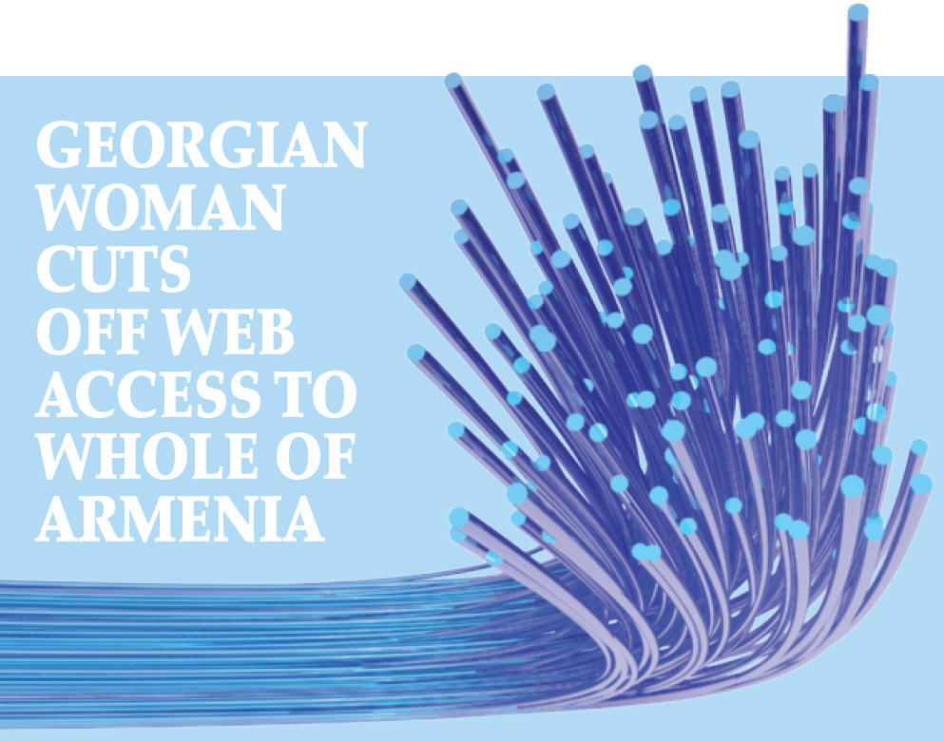
An elderly Georgian woman has accidentally cut through an underground cable and cut off internet services to a whole country, Armenia.
The woman, 75, was digging for metal near the Georgian capital Tbilisi and her spade damaged the cable. Unfortunately, Georgia provides 90 per cent of Armenia’s internet. Unfortunately, Georgia provides 90 per cent of Armenia’s internet. Web users
in the nation of 3.2 million people were left with no internet for up to five hours. Large parts of Georgia and some areas of Azerbaijan were also temporarily affected. The damage was discovered by an automatic system and a security team immediately went to the place where the cable was cut. The cable is protected, but apparently landslides or heavy rain may have left it exposed on the surface. The woman, called ‘the spade-hacker’ by local newspapers, was arrested for damaging property. She may have to spend up to three years in prison.
6e-p. 77

Slide 3
6e In the news
Writing a news story
1 Work in pairs. Read the news story. Do you think it is true or not? Explain your reasons to your partner.
It's a true story.
2 Writing skill structuring a news story
a Read the introductory sentence in the news story again. Answer the questions.
1 What happened?
2 Who was involved?
3 Where did it happen?
1 A woman accidentally cut through an underground cable.
2 an elderly Georgian woman
3 in Georgia
6e-p. 77

Slide 4
b Read the main paragraph and find:
1 how the woman cut the cable.
2 four things that happened after she cut the cable.
3 two pieces of background information.
1 She was digging for metal when her spade damaged the fibre-optic cable.
2 Internet services to Armenia were cut off; A monitoring system detected the damage; A security team went to the sport; The woman was arrested.
3 Possible answers could include: The woman was digging for metal; Georgia provides 90 per cent of Armenia’s internet; Web users in the nation of 3.2 million people were left twiddling their thumbs; The cable is protected, but apparently landslides or heavy rain may have left it exposed on the surface; The woman has been called ‘the spade-hacker’ by local media.
c Read the main paragraph again. How are the events and background details organized?
The main events are in chronological sequence.
Background information is inserted after the main event it relates to.
6e-p. 77

Slide 5
3 Vocabulary -ly adverbs in stories
a Find these adverbs (1–5) in the story. Then match the adverbs with their meanings (a–e).
b
e
c
a
d
1 accidentally
2 unfortunately
3 temporarily
4 immediately
5 apparently
a at once
b by mistake
c for a short time
d it seems
e we are sorry to say
6e-p. 77

Slide 6
b Cross out any options which are not possible.
1 Apparently, / Quickly, this type of incident is increasing in Georgia.
2 Fortunately, / Incredibly, nobody was hurt.
3 Internet services were amazingly / gradually restored across the region.
4 Coincidentally, / Rapidly, internet services also failed in other regions last week.
5 Software providers say hackers deliberately / sadly damaged the service.
6 Hopefully, / Slowly, the police will release the woman because of her age.
both are possible
c Work in pairs. Decide which of the sentences in Exercise 3b fit into the story and where they fit.
3 Internet services were gradually restored across the region.
This could go after ‘… temporarily affected.’
6 Hopefully, the police will release the woman because of her age.
This could go after ‘… three years in prison.’
6e-p. 77

Slide 7
4 You are going to write an April Fools’ story or a news story that is not true. This can be invented or it can be a story you have heard. First, make notes about the main events and the background details of the story. Think about what? who? where? and also why? and how?
5 Write an introductory sentence to summarize the story. Then number your notes in the order you will write about them. Include at least three adverbs where appropriate.
6 Work on your own. Write your story in about 150–200 words. Write an interesting headline.
7 Work with a new partner. Exchange stories. Use these questions to check your partner’s story.
• Did the headline make you interested in reading the story?
• Are the facts of the story clear?
• Do you think the story is true?
6e-p. 77

Slide 8
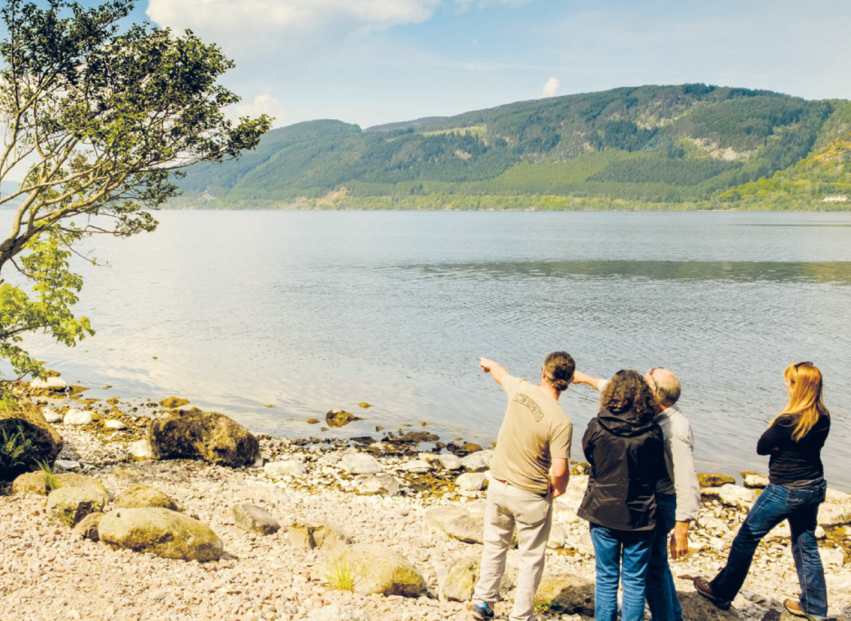
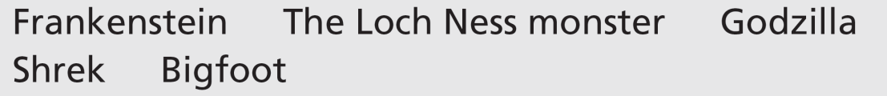
6f Encounters with a sea monster
Before you watch
1 How much do you know about these monsters? Compare your ideas with the class.
See next slide for answers
What could that be?
6f-p. 79

Slide 9
Exercise 1
EXAMPLE ANSWERS
Frankenstein: Victor Frankenstein is a young scientist who creates a monster in Frankenstein: or, the Modern Prometheus, a novel written by English author Mary Shelley in 1818. In films, the monster is often shown as huge, tall and slow-moving.
The Loch Ness monster: Loch Ness is a long, deep lake in Scotland. Legend has it that there is a monster in the loch. There are photographs showing what seems to be a dinosaur-like monster but nothing has been proved despite many investigations.
Godzilla: This is a fictional giant monster originating from a series of tokusatsu films of the same name from Japan. It first appeared in Ishiro Honda’s 1954 film Godzilla. It looks a bit like a T Rex dinosaur lizard. Bought to life by nuclear weapons testing, it destroys cities.
Shrek: Shrek is a friendly, green ogre. Shrek first appeared in a fairy tale picture book before the making of a 2001 American computer-animated fantasy-comedy film. He is voiced by Mike Myers.
Bigfoot: Bigfoot is the name given to a mythological apelike creature that is said to inhabit forests, mainly in the Pacific Northwest of the United States. Many consider sightings to actually be a bear (or a man in a gorilla suit).

Slide 10
2 Key vocabulary
a Read the sentences. Try to guess the missing words.
1 Don’t take the boat out past the red ____________.
2 Police talked to several ____________ who saw the accident.
3 Do camels have one ____________ or two?
4 Can you switch off the boat’s ____________, please? It’s very noisy.
5 It’s surprising how quickly submarines can ____________ into the water and disappear.
6 There were lots of seabirds following the ____________ of the ferry.
buoy
eyewitnesses
hump
motor
submerge
wake
6f-p. 79

Slide 11
b Read the words in bold and their definitions. The words are used in the video. Complete the sentences in Exercise 2a with the words.
a motor (n) an engine
b buoy (n) a coloured object that floats in water to indicate danger for boats
c eyewitnesses (n) people who see something happen, especially an accident, a crime, etc.
d hump (n) something that has a round shape and that sticks out
e wake (n) the waves behind something that moves through water
f submerge (v) to go under the surface of water
6f-p. 79

Slide 12

While you watch
3 Work in pairs. Watch the first part of the video (0.00–0.51) with the sound OFF. You will see Bob Iverson explaining something he saw as an eyewitness. What do you think he’s saying to the reporter?
Students’ own ideas
4 Watch the video with the sound ON. You will hear three eyewitness reports in total from Bob Iverson, Marjory Neal and Richard Smith. Correct the factual mistakes in the sentences.
1 All three eyewitnesses saw the monster on different days.
2 Only one eyewitnesses saw three or more humps.
3 All three eyewitnesses were in different places.
4 Only two eyewitnesses were alone at the time.
All three eyewitnesses …
1 saw the monster on the same day.
2 saw three or more humps.
3 were in exactly the same place.
4 were alone at the time.
6f-p. 79

Slide 13
5 Work on your own. Watch the video again. Make notes to answer the questions for each speaker.
1 Where was the eyewitness?
2 What were the weather or water conditions like?
3 How far away from the eyewitness was the monster?
4 What did the monster do?
6 Work in groups of three. Compare your notes. Is there any information still missing? If you need to, watch the video again and check.
Richard Smith:
1 in a boat
2 a nice, clear day
3 very close (‘at point blank range’)
4 disappeared, then came up again
Bob Iverson:
1 in his garden looking out over the water
2 calm water, dead flat
3 three hundred yards away
4 it went up, then down, up, then down, and then it was gone
Marjory Neal:
1 on her sundeck 2 no information
3 twenty or thirty feet beyond the mooring buoy
4 went across her view, then went down leaving a massive wake
6f-p. 79

Slide 14
Videoscript
Encounters with a sea monster
Part 1
0.00–0.51 Bob Iverson In August of 1997 I was sitting there, just looking out over the water. The water was absolutely dead flat calm, even calmer than it is now. All of a sudden three or four humps came up and then they went down and then they were up and then they were down. That caught my attention. Then I saw it two or three hundred yards up towards the green buoy there and that’s what really made me wonder what it was because of the speed going from that point to that point. And it was gone.
Part 2
0.52–0.59 Narrator Seven years later only seven miles away, another unlikely monster spotter was on her sundeck.
1.00–1.37 Marjory Neal It happened, I would say, anywhere between twenty and thirty feet behind the mooring buoy, that’s when I first saw it. It went right across my view and then all of a sudden it went down. But there was nothing else out here and it left this massive wake.
I knew I wasn’t dreaming when I saw the wake. It took up the total view that we can see from our deck.
1.39–1.49 Narrator A few miles east and twenty years before, another encounter. And this time at point blank range.

Slide 15
Videoscript
Encounters with a sea monster
1.50–2.40 Richard Smith It was March and it was a nice clear day, so I came out here with a friend visiting.
As we were going out, there were two humps in the water. So I headed off towards it and it submerged. I judged roughly where it had disappeared, turned the motor off and let it coast towards it. And while we still, while we were moving, it came up again, two humps in the water like tractor tyres. We could have touched the thing we were so close.
2.41–2.53 Narrator Three upstanding citizens, three remarkable stories. But are there more plausible explanations before we cry Sea Monster?

Slide 16
After you watch
7 Work in groups of three. Read what the reporter says at the end of the video. Discuss your ideas for possible explanations.
‘… three remarkable stories, but are there more plausible explanations before we cry “sea monster”?’
EXAMPLE ANSWERS
Plausible explanations for ‘Nessie’: an unusually large eel (long, snake-like fish), the wake of a large bird taking off from the water, a Greenland shark, smaller animals such as otters seen in such a way that they look bigger, misshapen trees in the water, a mirage or optical effect on the water, gases coming from the water, a hoax (there have definitely been hoaxes – perhaps local people have tried to attract tourists by making a hoax Nessie and photographing it)
6f-p. 79

Slide 17

8 Vocabulary in context
a Watch the clips from the video. Choose the correct meaning of the words and phrases.
b Complete the sentences in your own words. Then work in pairs and compare your sentences.
1 I was on my way to class once when all of a sudden …
2 Sometimes when I watch TV, I wonder …
3 I spend anywhere between … hours studying English each week.
4 A news story about ... caught my attention last week.
EXAMPLE ANSWERS
1 I was on my way to class once when all of a sudden it started to rain / I fell over.
2 Sometimes when I watch TV, I wonder what is happening to the world / whether there isn’t anything better to do.
3 I spend anywhere between 10 to 12 / 13 to 82 hours studying English each week.
4 Students' own ideas
6f-p. 79

Slide 18
Videoscript
Encounters with a sea monster
c
b
c
a
c
1 All of a sudden, these three or four humps came up ...
a at the same time
b slowly and quietly
c very quickly, with no warning
2 ... they were up and then they were down. That caught my attention.
a I didn’t understand.
b I noticed it.
c It looked at me.
3 ... that’s what really made me wonder what it was because of the speed ...
a believe it
b identify it
c question it
4 It happened, I would say, anywhere between twenty and thirty feet behind the mooring buoy ...
a approximately twenty or thirty
b less than twenty or thirty
c more than twenty or thirty
5 ... another encounter. And this time at point blank range.
a a long way away
b at an unknown distance
c extremely close

Slide 19
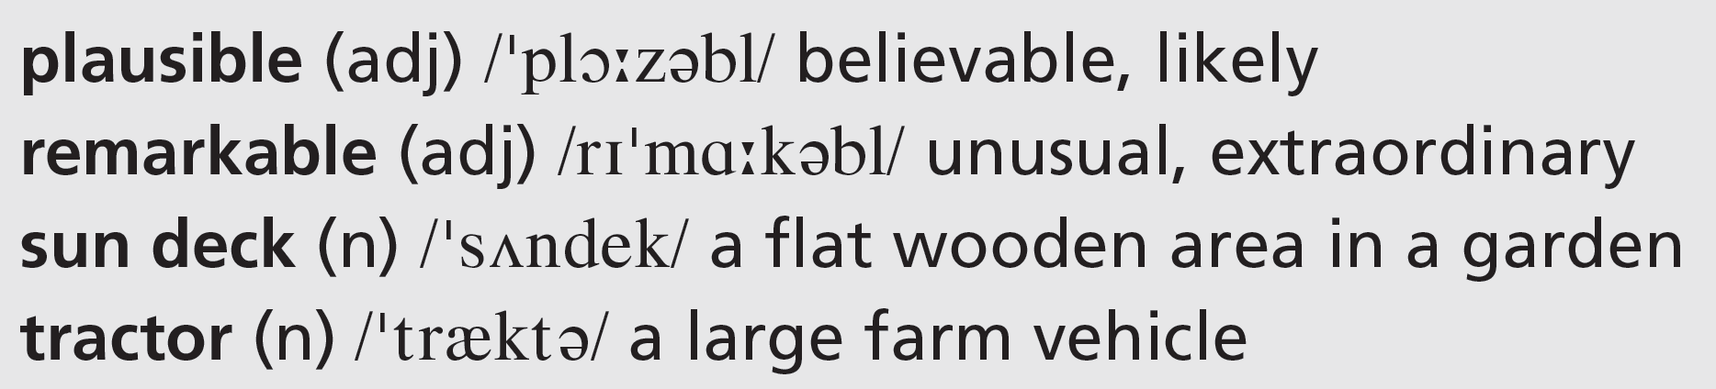
9 Would you believe a friend if they told you a story like the ones in the video? Why? / Why not?
6f-p. 79

Slide 20
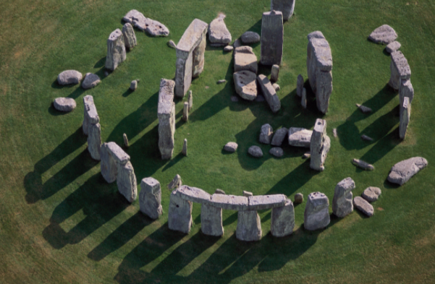
UNIT 6 REVIEW AND MEMORY BOOSTER
Grammar
1 Choose the correct options in the text about Stonehenge.
Stonehenge dates from 3–4,000 years ago. Although there 1 are / might be no written records from that period, some people think Stonehenge 2 can’t have / might have been part of King Arthur’s court. Others say invaders from Denmark 3 couldn’t have / could have built it or it 4 can / could be the ruins of a Roman building. The larger stones weigh 25 tons and they come from about 30 kilometres away from the site. The smaller stones originate from Wales, 230 kilometres away.
U6 Review-p. 80

Slide 21
Stonehenge 5 is / may be in the shape of a circle and the stones are placed 6 so that / to they match the sun’s highest and lowest points in the sky. This has led people to suggest that it 7 can’t have / could have been a scientific observatory or it was designed 8 for / to help aliens land. On the other hand, others believe it 9 can / may be a kind of cemetery – a place 10 for / so that burying people. Every year brings new theories about the true purpose of Stonehenge.
2 Answer the questions about the text in Exercise 1.
1 What are three theories about the origins of Stonehenge?
2 What is known about the stones?
3 What are three theories about the purpose of Stonehenge?
See next slide for answers
U6 Review-p. 80

Slide 22
Exercise 2
1 a It might have been part of King Arthur’s court.
b Invaders from Denmark could have built it.
c It could be the ruins of a Roman building.
2 The larger stones weigh 25 tons and they come from about 30 kilometres away from the site. The smaller stones originate from Wales, 230 kilometres away. Stonehenge is in the shape of a circle and the stones are placed so that they match the sun’s highest and lowest points in the sky.
3 a It could have been a scientific observatory.
b It was designed to help aliens land.
c It may be a kind of cemetery.

Slide 23

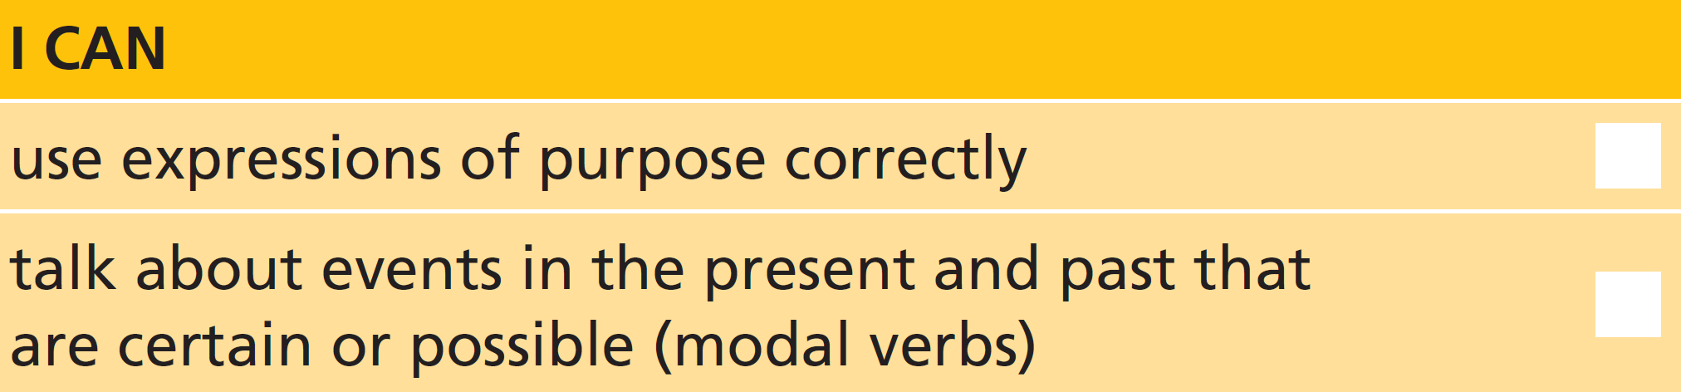
3 Work in pairs. Which theory about Stonehenge do you think is the most likely? Give reasons.
U6 Review-p. 80

Slide 24
Vocabulary
4 Complete the sentences with an adverb ending in -ly. The first letter is given.
1 I’d love to come for lunch, but u__________________ I’m busy that day.
2 You need to reply to this letter i__________________. It’s urgent.
3 Oh dear, I’ve a__________________ deleted the email. How did that happen?
4 I’m working t__________________ as the manager while my boss is away.
5 We checked our records and a__________________ the package was posted on 2 May.
6 I think the boys arrived late d__________________ to miss the test.
unfortunately
immediately
accidentally
temporarily
apparently
deliberately
U6 Review-p. 80

Slide 25
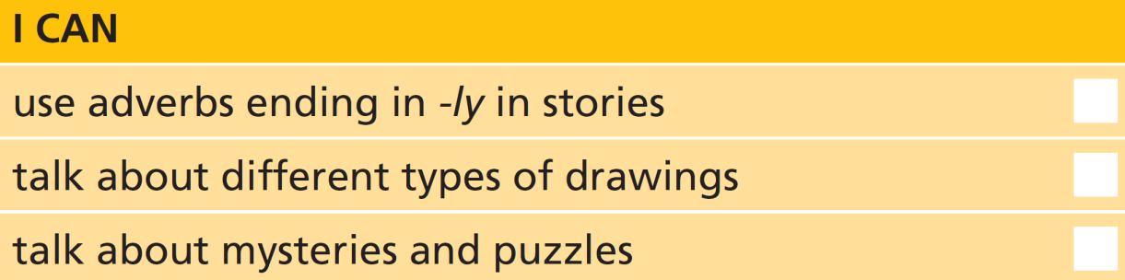
5 Work in pairs. Answer as many questions as you can. The words in bold are in Unit 6.
1 What are false eyelashes?
2 What do you understand by the expression ‘flexible thinker’?
3 When might you get a reward?
4 Name two activities you could do all day long.
5 How many shapes can you name?
6 Are lines always straight?
7 Give examples of how to use record as a noun and as a verb.
8 Is a hoax a person?
9 What’s the difference between a trick and a puzzle?
10 What do you use a spade for?
See next slide for answers
U6 Review-p. 80

Slide 26
Exercise 5
EXAMPLE ANSWERS
1 They are eyelashes that are not real / ones you put on and take off.
2 A flexible thinker is someone who can solve problems that don’t have a clear answer.
3 You might get a reward when you do something well and receive something in return, e.g. you find something and return it to the police/owner.
4 Students’ own answers, for example: sleep, sunbathe, relax, watch TV
5 Students’ own answers, for example: circle, rectangle, square, triangle, oval, sphere, star, cube, diamond, pentagon, hexagon, etc.
6 no
7 Students’ own answers, for example: She broke the world record. (noun), He’s recorded a new song. (verb), She’s got some cycling records. (noun), I’ve made a record of our conversation. (noun)
8 No, a hoax is a thing, a plan to deceive someone.
9 A trick is something you do to deceive someone; a puzzle is an activity in which you have to put pieces together or answer questions using skill.
10 for digging

Slide 27

Real life
6 Complete the expressions for reacting to news.
1 __________ __________ __________ joking!
2 __________ off __________!
3 __________ __________ __________ on!
4 __________ __________ __________ right!
5 __________ __________ serious?
6 __________ __________ sure?
You
must
be
Come
it
You’re
having
me
That
can’t
be
Are
you
Are
you
7 Work in groups. Write surprising sentences about yourself (true and false). Take turns to read out your sentences. Use appropriate expressions to react to the sentences about the other people and try to find out which sentences are true.
U6 Review-p. 80

Slide 28
Communication activities
UNIT 6a Exercise 2, page 70
Well, clearly the matches are to light the candle with and we know that drawing pins are for attaching things to other things. But what about the box? Yes, it’s for holding the drawing pins. But you can also use it to hold the candle. And then you attach the box to the wall. Did you get it? Yes? Congratulations, you’re a flexible thinker.
p. 155

